Slide 1
CT4029 Principles of Programming Day 1 – Session 1 – Part 2 Computer Architecture & Basics of Programming

Slide 2
Learning Outcomes
Problem Solving Techniques
What makes up a computer?
How and why various components in a computer interact?
Basics of a computer programme

Slide 3
Today’s Agenda !
Problem Solving
Problem Solving Strategies (Flowchart, Pseudocode)
Computing Architecture
First Program

Slide 4

Problem Solving

Slide 5
Problem solving approaches
Hercule-Poirot approach
Breakdown into smaller logical units
Logically putting together evidence
Jane-Marple approach
Finding analogies relevant/similar to the problem at hand
Hit and trial approach
Brute force …
Can you find other problem-solving approaches?

Slide 6
Visualise it …
“While thinking about your solution is useful, writing it down even more so for two reasons. First, once written an idea can be retrieved. The second reason is that writing something down requires thinking very clearly about it”
How to think like a programmer. (2008)

Slide 7
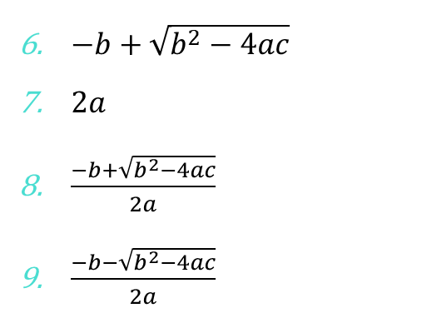
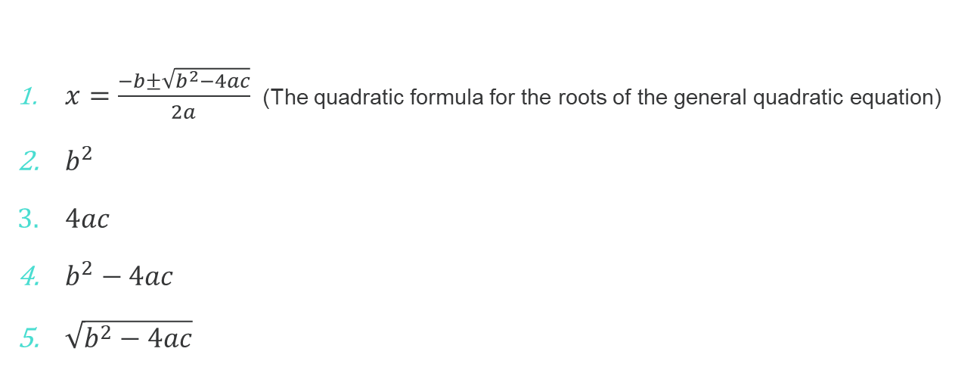
Example (Decomposition)
$x=\frac{−b±\sqrt{b^{2}−4ac}}{2a}$ (The quadratic formula for the roots of the general quadratic equation)
$b^{2}$
$4ac$
$b^{2}−4ac$
$\sqrt{b^{2}−4ac}$
$−b+\sqrt{b^{2}−4ac}$
$2a$
$\frac{−b+\sqrt{b^{2}−4ac}}{2a}$
$\frac{−b−\sqrt{b^{2}−4ac}}{2a}$

Slide 8
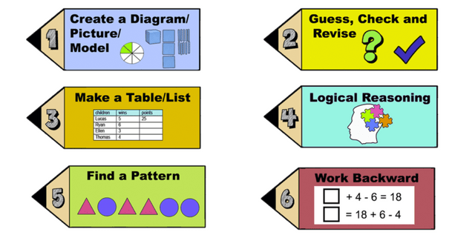
Problem Statement Breakdown
Givens
Initial state, values
Goals
Outcome, objectives
Single/multiple
Hierarchical/exclusive
Resources
Given
Needed

Slide 9
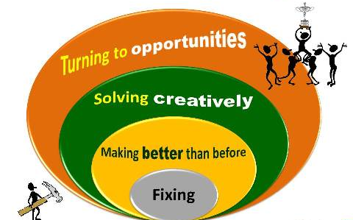
Problem Solving Strategies

Slide 10
Problem Solving Tools
Pseudocode
Storylines, itemised/sequenced lists
Diagrams
Storylines, timelines
Flowcharts
Sequence diagrams
Block diagrams, state machines, collaboration diagrams
Visualisations

Slide 11
Problem Solving Tools: Pseudocode
Making a cup of tea
START
Fetch a tea cup
Add 300 ml of water to the kettle
Boil the water until the kettle switches itself off
Place a new tea bag into the bottom of the cup
Pour 200 ml of boiling water from the kettle, into the cup
Leave the tea bag to stew for 10 seconds
Use a metal spoon to stir the tea bag for 3 seconds
Using the spoon, remove the tea bag from the cup
Dispose of the tea bag
END

Slide 12
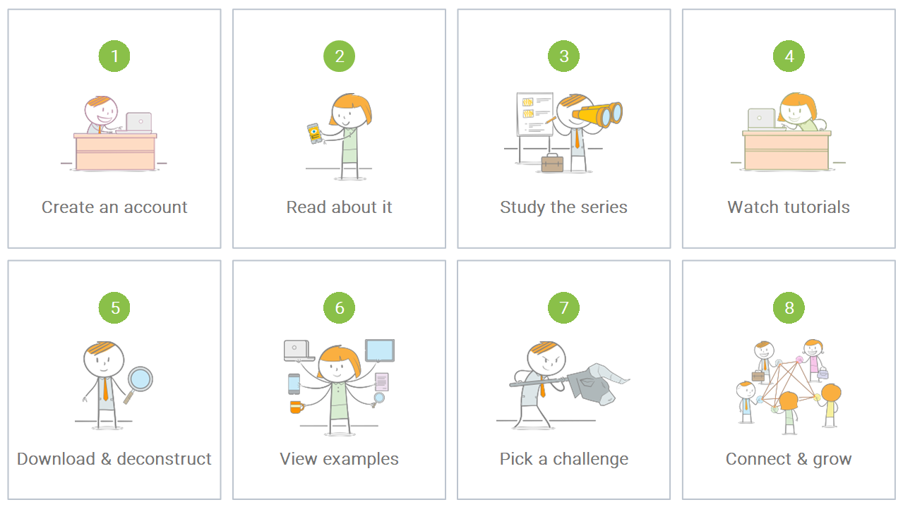
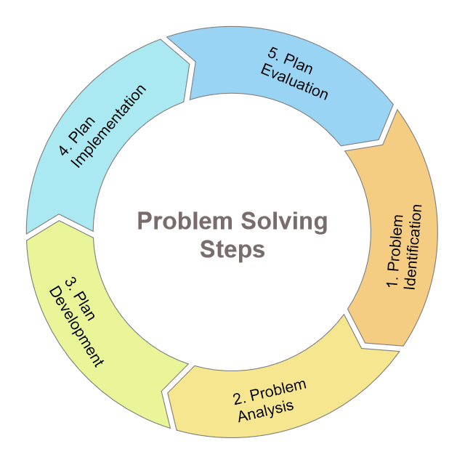
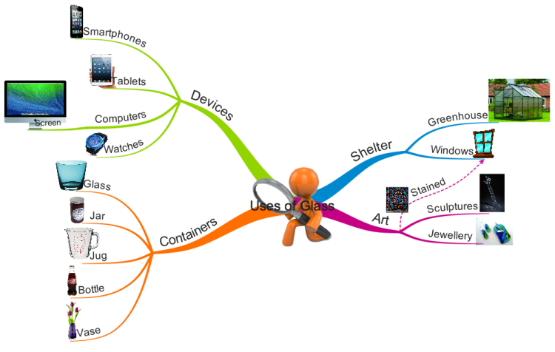

Problem Solving Tools: Diagrams
Storylines
Mind Maps
Timelines

Slide 13
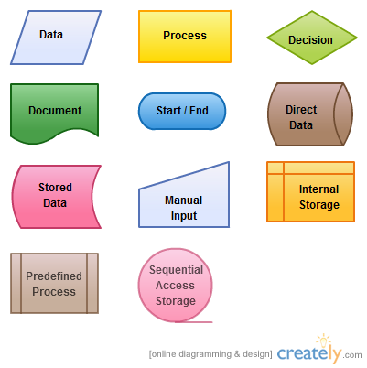
Problem Solving Tools: Flowcharts
Example: Authentication
Start
Start
Input
Username/
password
Process
Check length
Try again
Condition
Match
login
pwd
False
False
True
True
Process
Load user profile
End
End

Slide 14
Computing Architecture

Slide 15
Functional Units of a Computer (1/2)
Arithmetic and logic unit (ALU):
Performs the desired operations on the input information as determined by instructions in the memory
Input
Stores Information
Arithmetic
& Logic
Output
Control
I/O
Memory
Processor
Control unit
coordinates various actions:
Input,
Output
Processing
Notes:
Instructions control “what” operations take place (e.g. data transfer, processing).
Control unit generates timing signals which determines “when” a particular operation takes place.
Primary storage of the computer consists of RAM units.
Fastest, smallest unit is Cache.
Slowest, largest unit is Main Memory.
Primary storage is insufficient to store large amounts of data and programs.
Primary storage can be added, but it is expensive.
Store large amounts of data on secondary storage devices:
Magnetic disks and tapes,
Optical disks (CD-ROMS).
Access to the data stored in secondary storage in slower, but take advantage of the fact that some information may be accessed infrequently.
Cost of a memory unit depends on its access time, lesser access time implies higher cost.

Slide 16
Functional Units of a Computer (2/2)
Processor
Memory
General purpose,
parallel,
asynchronous bus
System Bus
Data Bus
Address Bus
Control Bus
IO Interface
IO Interface
IO Device
IO Device
Notes:
Memory unit stores instructions and data.
Data is represented as a series of bits.
To store data, memory unit thus stores bits.
Processor reads instructions and reads/writes data from/to the memory during the execution of a program.
In theory, instructions and data could be fetched one bit at a time.
In practice, a group of bits is fetched at a time.
Group of bits stored or retrieved at a time is termed as “word”
Number of bits in a word is termed as the “word length” of a computer.
In order to read/write to and from memory, a processor should know where to look:
“Address” is associated with each word location.

Slide 17
Memory Unit
Processor reads/writes to/from memory based on the memory address:
Access any word location in a short and fixed amount of time based on the address.
Random Access Memory (RAM) provides fixed access time independent of the location of the word.
Access time is known as “Memory Access Time”.
Memory and processor have to “communicate” with each other in order to read/write information.
In order to reduce “communication time”, a small amount of RAM (known as Cache) is tightly coupled with the processor.
Modern computers have three to four levels of RAM units with different speeds and sizes:
Fastest, smallest known as Cache
Slowest, largest known as Main memory.
Notes:
Since the instructions and data need to be feteched from the memory in order to perform a task, the time it takes to access and fetch this information will be one factor influencing how fast a given task will complete. In order to increase the speed of performing a task, one way is to reduce the amount of time it takes to fetch the data and the instructions. This time is called as “access time”.
Suppose if we want to fetch the data at memory location with the address 10. In case of sequential access, we have to access locations 1-9, and then access location 10. Clearly, in case of sequential access the access times increase as memory locations with higher access times are accessed. We need some kind of memory which provides fixed and short access time irrespective of the memory location being accessed. That is, it provides random access.
Why is the access time faster for the Cache than it is for primary storage? I haven’t yet discussed how the various units communicate with each other. In a few minutes I will discuss that, and it will become clear.

Slide 18
Instructions
Transfer information
within a computer
between the computer and I/O devices
Perform arithmetic and logic operations
Add two numbers
Perform a logical AND
Fetched from memory
Require address
What is an instruction made up of?
Action + Subject / Object
What do the instructions operate upon?
Notes:
A sequence of instructions to perform a task is called a program, which is stored in the memory.
Processor fetches instructions that make up a program from the memory.

Slide 19
Instruction set
A set of actions/tasks that a processor recognises, understands and can execute.
Instructions are either atomic in nature or they are not
What do we mean by this is that there are two types of instruction sets
CISC (Complex Instruction Set Computing)
RISC (Reduced Instruction Set Computing)

Slide 20
Data
Data are the “operands” upon which instructions operate.
Data could be:
Numbers
Characters
Memory addresses
Any digital information

Slide 21
First Programme “Hello Python!”

Slide 22
Program
A sequence of instructions to perform a task is called a program, which is stored in the memory.
Processor
fetches instructions that make up a program
from the memory and
executes them in a sequence.

Slide 23
Program: Set of instructions
Bake a Cake
Calculate 12 + 12
#I assume knowledge of kitchen appliances
#I assume knowledge of measuring/temperature units
1. Turn on Oven, preheat to 180C
#Get bowls, cups, measuring spoons
2. Measure 2 cups raising flour
3. Measure 1 cup milk
4. Get 2 cups sugar
5. Mix ingredients in a baking bowl
6. Check Oven, if not 180C
6.1. Wait 3 min, check again, step-6
7. otherwise if it is 180C
7.1. Bake for 40 minutes
num1 = 12
num2 = 2
total = num1 + num2
print (total)
Notes:
Explain with algebraic example

Slide 24
Levels of interpretation (1/2)
Solution
Create two numerical containers.
Insert numerical values to the containers
Add first value to the second value
High-level Language
Program
int a = 10;
int b = 20
int sum = a+b;
Assembly Language Program
movq %rsp, %rbp
movl %edi, -4(%rbp)
movl %esi, -8(%rbp)
cmpl $1, -4(%rbp)
Machine Language Program
0001 4889E5
0004 897DFC
0007 8975F8
000a 837DFC01
Control Signal Specification
Pin
Clock cycle

Slide 25
Levels of interpretation (2/2)
Add two numbers
Where are the numbers?
Who stores the numbers?
How can they be accessed?
Are they decimal or fractional numbers?
Create two decimal numerical values.
Add the two values.
1. Create a decimal number container
1.1. give it a unique name ‘a’
1.2. store a value in it.
2. Create a decimal number container
2.1. give it a unique name ‘b’
2.2. store a value in it.
3. Add the value stored in ‘a’ to the value stored in ‘b’
Solution

Slide 26
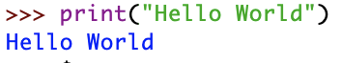
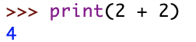
Programming Basics
Code or source code: The sequence of instructions in a program.
Syntax: The set of legal structures and commands that can be used in a particular programming language.
Output: The messages printed to the user by a program.
Console: The text box onto which output is printed.
Some source code editors pop up the console as an external window, and others contain their own console window.

Slide 27
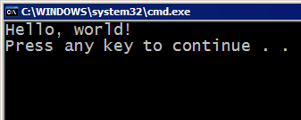
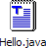
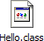

Compiling and Interpreting
Many languages require you to compile (translate) your program into a form that the machine understands.
Python is instead directly interpreted into machine instructions.
compile
execute
source code
Hello.java
byte code
Hello.class
output
interpret
source code
Hello.py
output

Slide 28
Expressions
Expression: A data value or set of operations to compute a value.
Examples: 1 + 4 * 3
42
Arithmetic operators we will use:
+ - * / addition, subtraction/negation, multiplication, division
% modulus, a.k.a. remainder
** exponentiation
Precedence: Order in which operations are computed.
* / % ** have a higher precedence than + - 1 + 3 * 4 is 13
Parentheses can be used to force a certain order of evaluation. (1 + 3) * 4 is 16

Slide 29
Integer Division
When we divide integers with / , the quotient is also an integer.
3 52
4 ) 14 27 ) 1425
12 135
2 75
54
21
More examples:
35 / 5 is 7
84 / 10 is 8
156 / 100 is 1
The % operator computes the remainder from a division of integers.
3 43
4 ) 14 5 ) 218
12 20
2 18
15
3
Notes:
Dividing by 0 crashes the program.

Slide 30
Real Numbers
Python can also manipulate real numbers.
Examples: 6.022 -15.9997 42.0 2.143e17
The operators + - * / % ** ( ) all work for real numbers.
The / produces an exact answer: 15.0 / 2.0 is 7.5
The same rules of precedence also apply to real numbers: Evaluate ( ) before * / % before + -
When integers and reals are mixed, the result is a real number.
Example: 1 / 2.0 is 0.5
The conversion occurs on a per-operator basis.
7 / 3 * 1.2 + 3 / 2
2 * 1.2 + 3 / 2
2.4 + 3 / 2
2.4 + 1
3.4

Slide 31

Welcome to PyCharm

Slide 32
Math Commands
Python has useful commands for performing calculations.
To use many of these commands, you must write the following at the top of your Python program:
from math import *
Command name | Description
abs(value) | absolute value
ceil(value) | rounds up
cos(value) | cosine, in radians
floor(value) | rounds down
log(value) | logarithm, base e
log10(value) | logarithm, base 10
max(value1, value2) | larger of two values
min(value1, value2) | smaller of two values
round(value) | nearest whole number
sin(value) | sine, in radians
sqrt(value) | square root
Constant | Description
e | 2.7182818...
pi | 3.1415926...

Slide 33
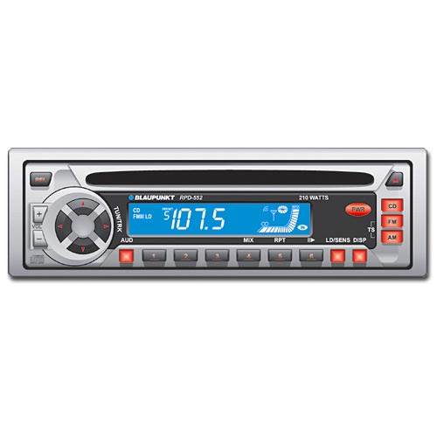
Variables
Variable: A named piece of memory that can store a value.
Usage:
Compute an expression's result,
store that result into a variable,
and use that variable later in the program.
Assignment Statement: Stores a value into a variable.
Syntax:
name = value
Examples: x = 5
gpa = 3.14
x 5 gpa 3.14
A variable that has been given a value can be used in expressions.
x + 4 is 9

Slide 34
print()
print : Produces text output on the console.
Syntax:
print ("Message”)
print (Expression)
Prints the given text message or expression value on the console, and moves the cursor down to the next line.
print (Item1, Item2, ..., ItemN)
Prints several messages and/or expressions on the same line.
Examples:
print ("Hello, world!”)
age = 45
print ("You have", 65 - age, "years until retirement”)
Output:
Hello, world!
You have 20 years until retirement

Slide 35
input()
input(): Reads a number from user input.
You can assign (store) the result of input into a variable.
Example:
age = input("How old are you? ")
print ("Your age is", age)
print ("You have", 65 - age, "years until retirement”)
Output:
How old are you? 53
Your age is 53
You have 12 years until retirement

Slide 36
Next Session!
Basics of Python
Variables and data types
Control structures
Loops
Switches
Conditions

Slide 37


